Slide 1
A Fine-grained Analysis on the Delays in Pull Requests of OSS Projects
Kazi Amit Hasan
Oct 21st, 2022

Slide 2
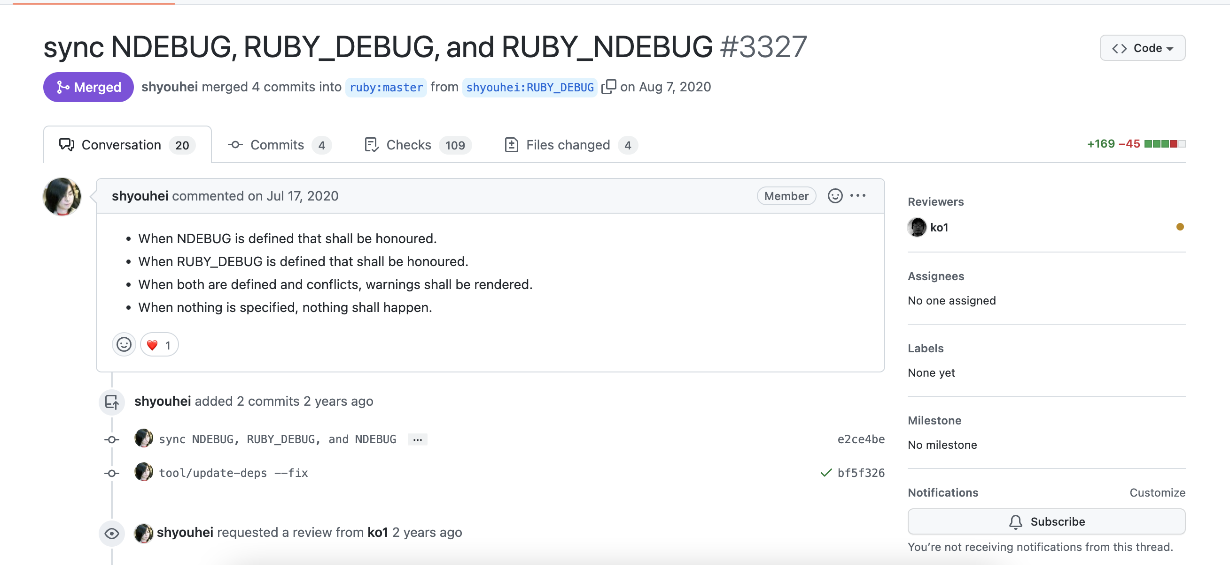
Pull Requests often got delayed in OSS projects.
PRs taking short/long time to merge/close [2]
One way to deal with such issue is to understand factors related to delays.
Build tool to warn stakeholders when a pending action has taken more than usual expected time, e.g., Microsoft Nudge [1].

Slide 3


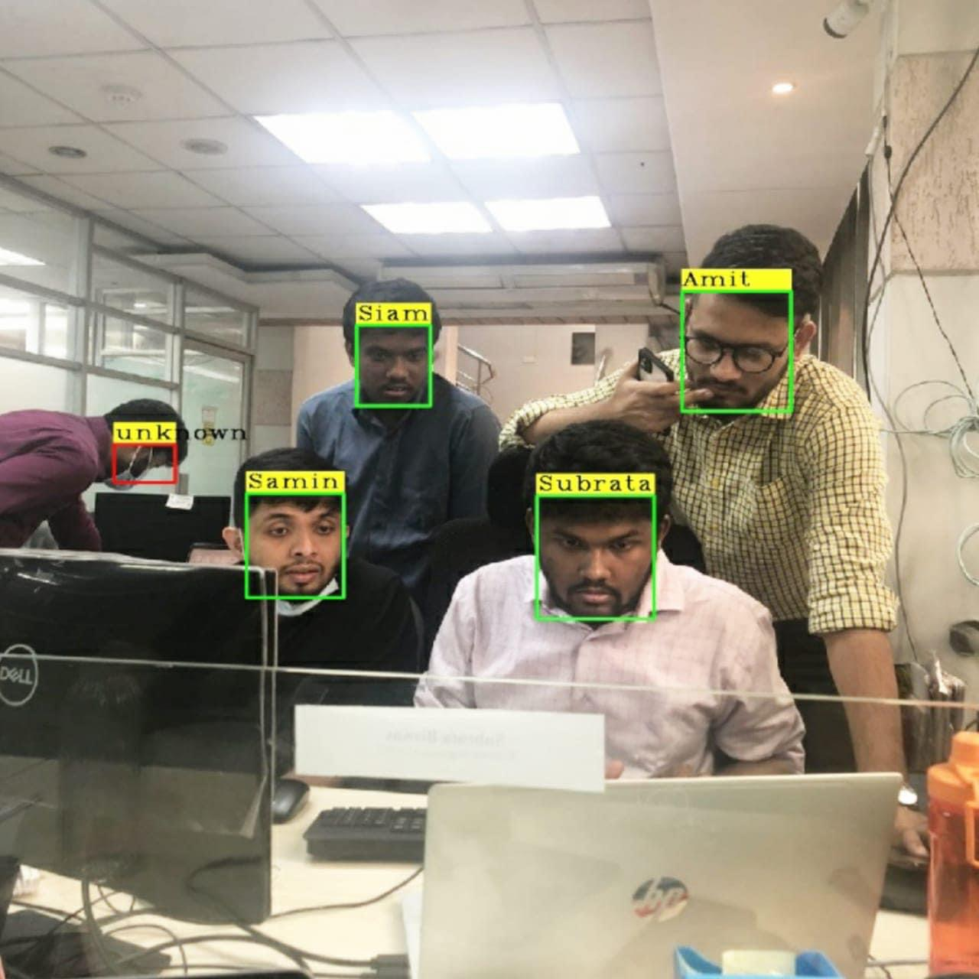
Delays could happen in different stages in the life of a PR
Existing studies focus on the whole lifespan (Open->Merged/Closed)
Closed
Approved
Merged
We focus on stage-level delays, Fine-grained!
Rejected
Comments on the Vn
Response to Comment, Update Vn
Comments on the V1
Response to Comment, Update V1
Comments on the PR
Open PR
Reviewer
PR Author

Slide 4
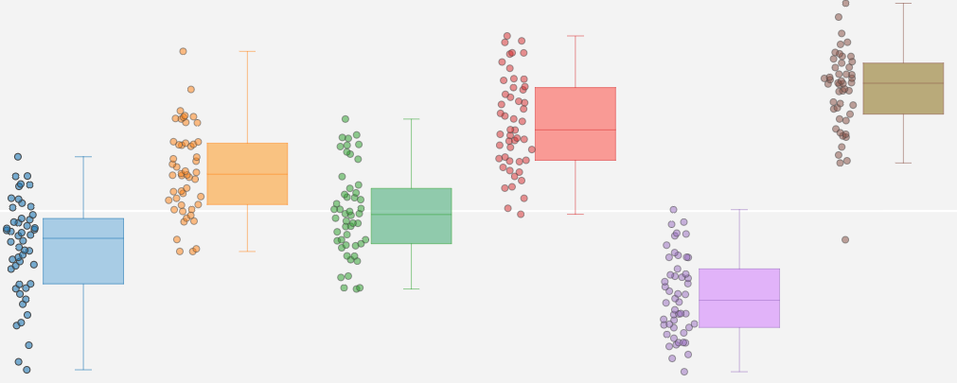
Research Questions
RQ1: Which stages experience the most delays?
RQ2: Can we characterize stage-level delays using multiple factors?
RQ3: How well do state-of-the-art PR effort estimation models perform on stages?
For each analyzed project, we will plot the distribution of time spent on each stage (first-to-first-response, time to update v1, review and comment on v1, etc.)
We will consider the characteristics of reviewer, PR author, project, and PR.
We would raise several hypothesis and test which factors can differentiate stage-level delays.
Microsoft Nudge [1] , PR Latency explained [3].

Slide 5
Data Collection
The OSS project should have active multiyear development history
Popular and representative in specific domains,
Containing enough Pull Requests,
Have clear signals for stage identification.

Slide 6
References
Maddila, Chandra, et al. "Nudge: accelerating overdue pull requests towards completion." ACM Transactions on Software Engineering and Methodology (2020).
Yu, Yue, et al. "Reviewer recommendation for pull-requests in GitHub: What can we learn from code review and bug assignment?." Information and Software Technology 74 (2016): 204-218.
Zhang, Xunhui, et al. "Pull request latency explained: An empirical overview." Empirical Software Engineering 27.6 (2022): 1-38.

Slide 7
